Slide 1
LOGISTICS REGRESSION
GRADED ASSIGNMENT
CREDIT SCORING MODEL
NEELAM AGARWAL
User ID: Jig11670

Slide 2
Problem Statement
A credit card company wants to build a credit scoring model, to predict the bad customers.
The company has data on customers involving the details about the demographic and credit bureau variables. Build a Data Scoring model on the data provided, also perform model validation to check how well the model will perform on new data.

Slide 3
Problem Assessment
In the problem given, model used to derive the output is Logistic Regression since output is discrete.
Started with Importing the file into SAS.
Data exploration and Data preparation of the data was done
Separated data equally into two sets, train and validate dataset
Percentage of number of 0’s to 1’s was
93.3 : 6.7
In the above dataset, 1 is referred to customers who defaulted on the credit card. So probability modeled is for NPA_Status=1

Slide 4
Code Snippet
Proc logistics data = train descending
/* descending is used because the model is for NPA_Status= 1*/
Model NPA_Status = age genderN Region1 Dependents House Occupation_N Edu NumberofOpenCreditLinesAndLoans NumOfTime30_59DaysPastDueNotW NumOfTime60_89DaysPastDueNotW NumberOfTIme90DaysLate/ ctable lackfit;
output out = pred p= predicted;
run;

Slide 5
Observation from the model
After doing multiple iterations, derived concordance of 79.7 and 19.
Confidence limit does not include 1
All the variables included in the model are significant
Convergence criterion is satisfied.
Screen shorts of findings for the above is presented in the following slides

Slide 6
findings

Slide 7
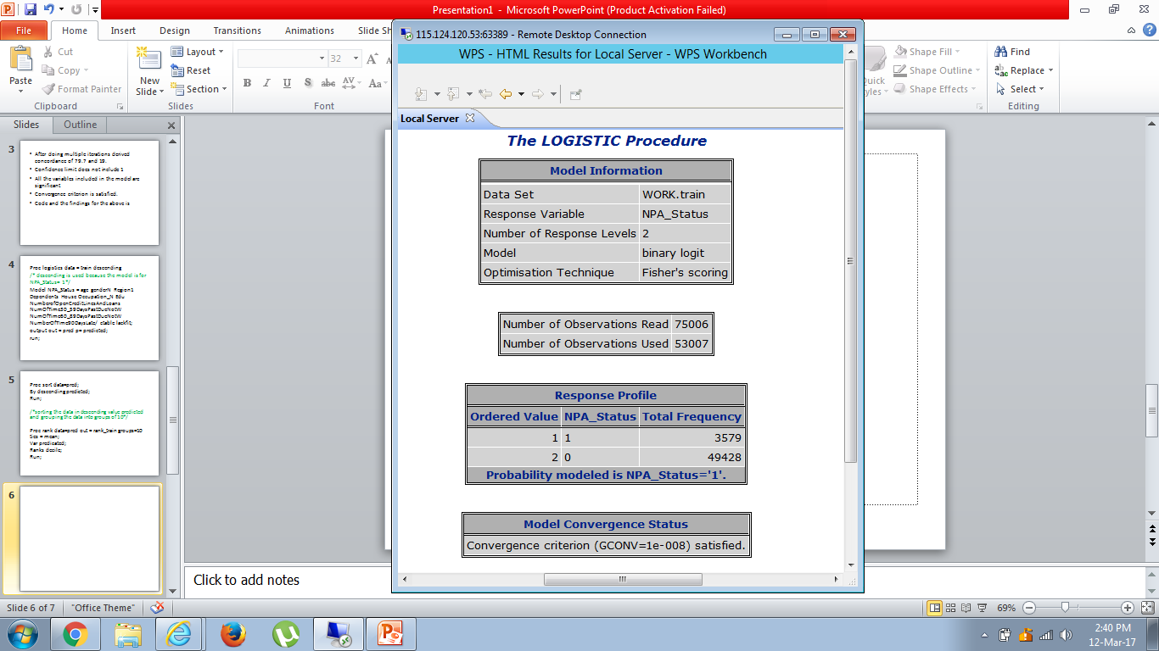

Slide 8
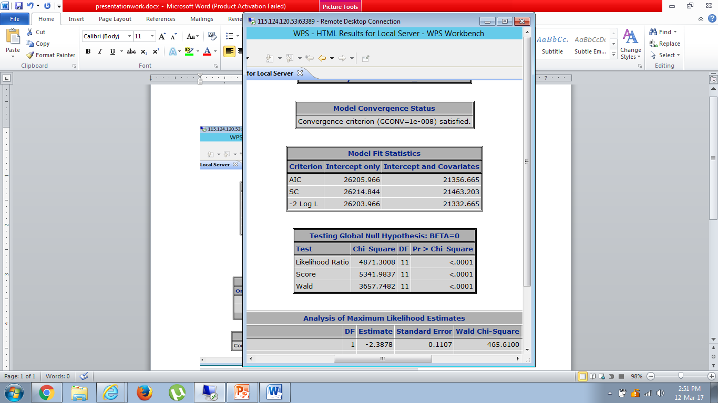

Slide 9
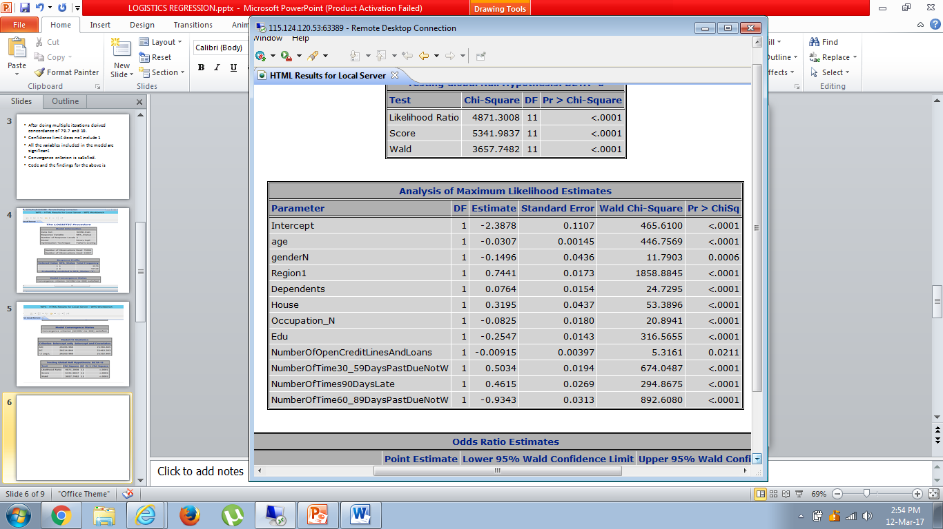

Slide 10
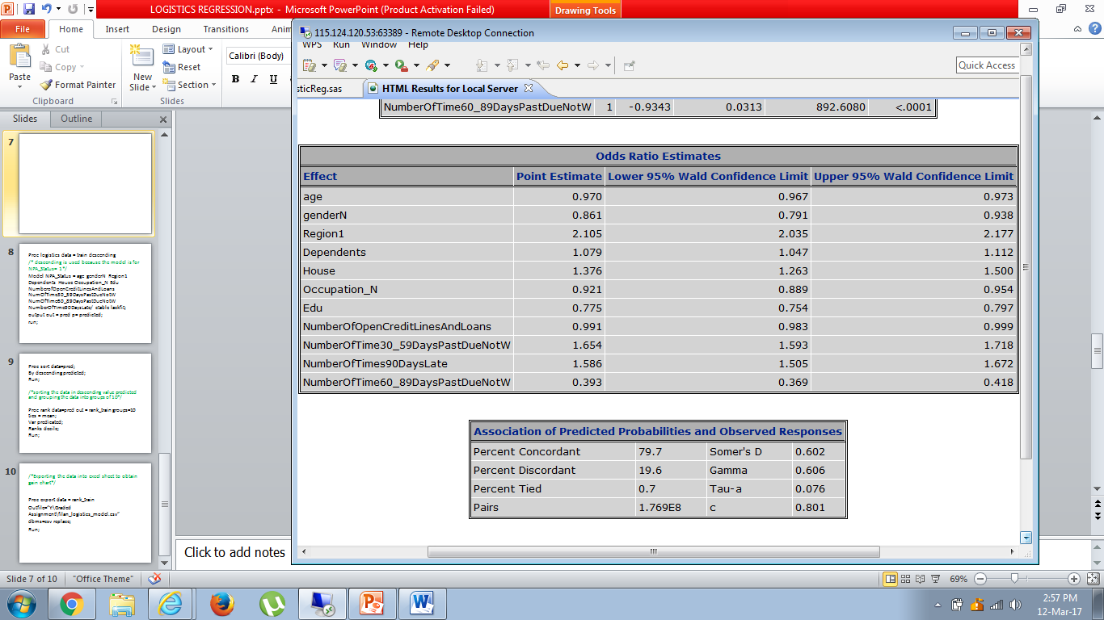

Slide 11
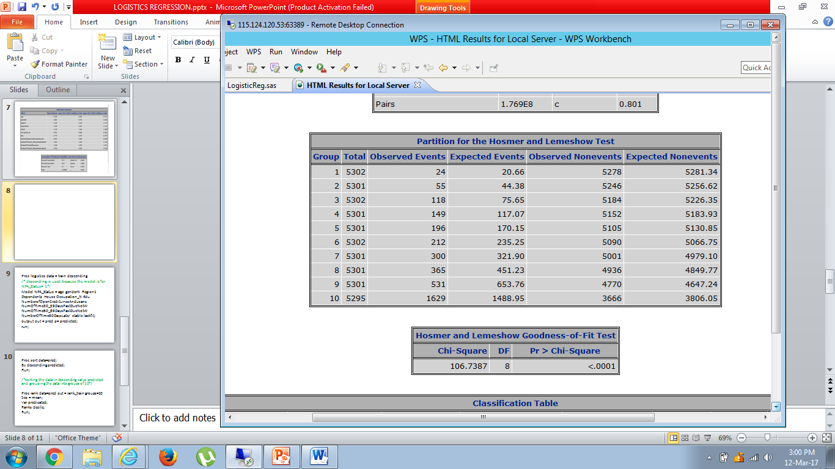

Slide 12
Validation
The same model was performed on validation dataset and same results were obtained from the same.
Concordance of 79.7 is obtained which indicates a good model.
Now data was exported to excel to derive Gain chart.

Slide 13
Program for Grouping Data
Proc sort data=pred;
By descending predicted;
Run;
/*sorting the data in descending value predicted and grouping the data into groups of 10*/
Proc rank data=pred out = rank_train groups=10 ties = mean;
Var predicated;
Ranks decile;
Run;

Slide 14
Log File Output Program
/*Exporting the data into excel sheet to obtain gain chart*/
Proc export data = rank_train
Outfile=“Y:\Graded Assignment\final_logistics_model.csv” dbms=csv replace;
Run;

Slide 15
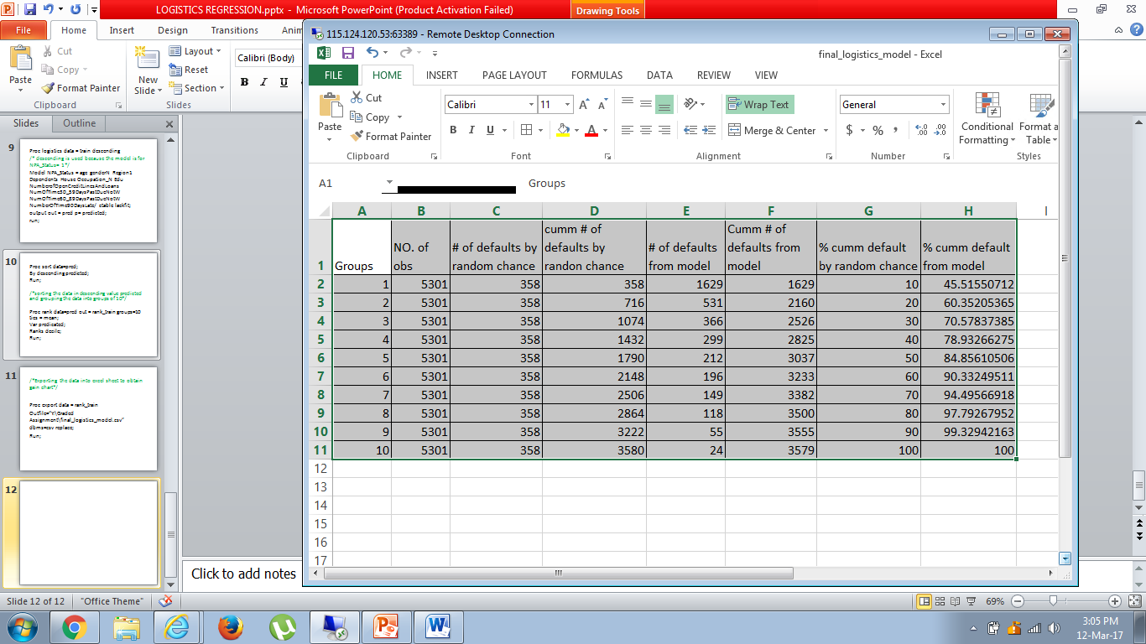

Slide 16
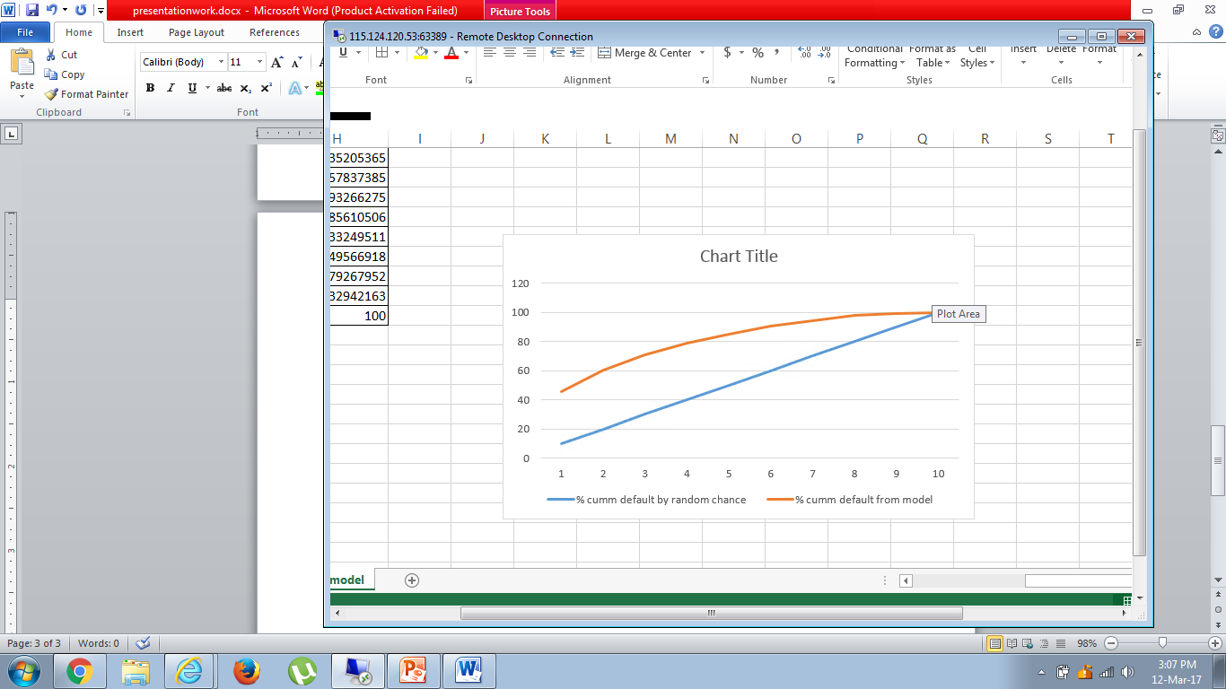
Gain chart

Slide 17
Observation
The more separated the orange line (model curve) is from the blue line(from random chance) the better is the model.
Hence the model is derived, significant variables are known, Gain chart is obtained.

